Slide 1
Photomicrographs of Plant foods
Bean: Composite of Parenchyma
Permission to reproduce original photomicrographs used to make this collection may be obtained from
Dr. David O. Norris at
david.norris@colorado.edu

Slide 2
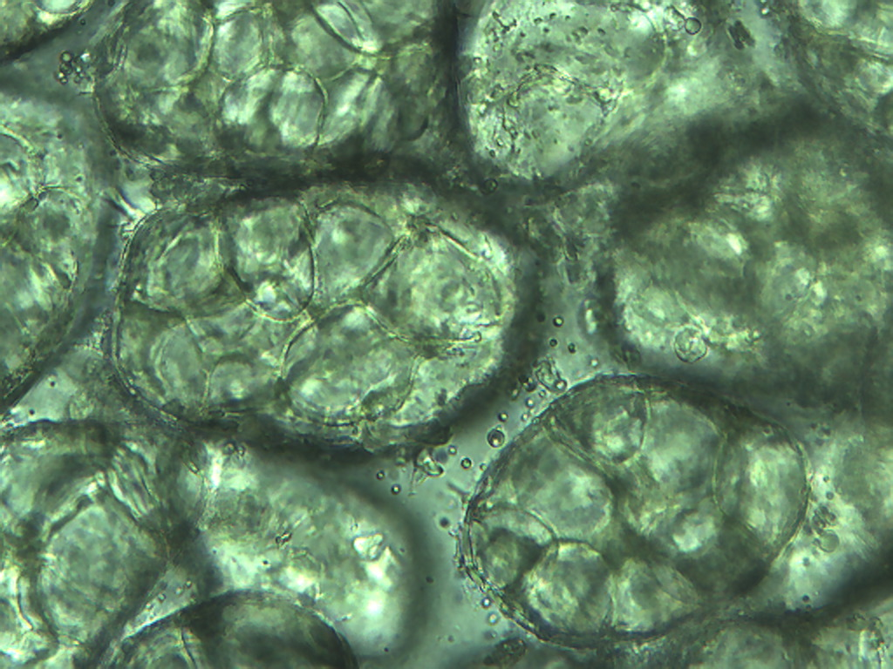
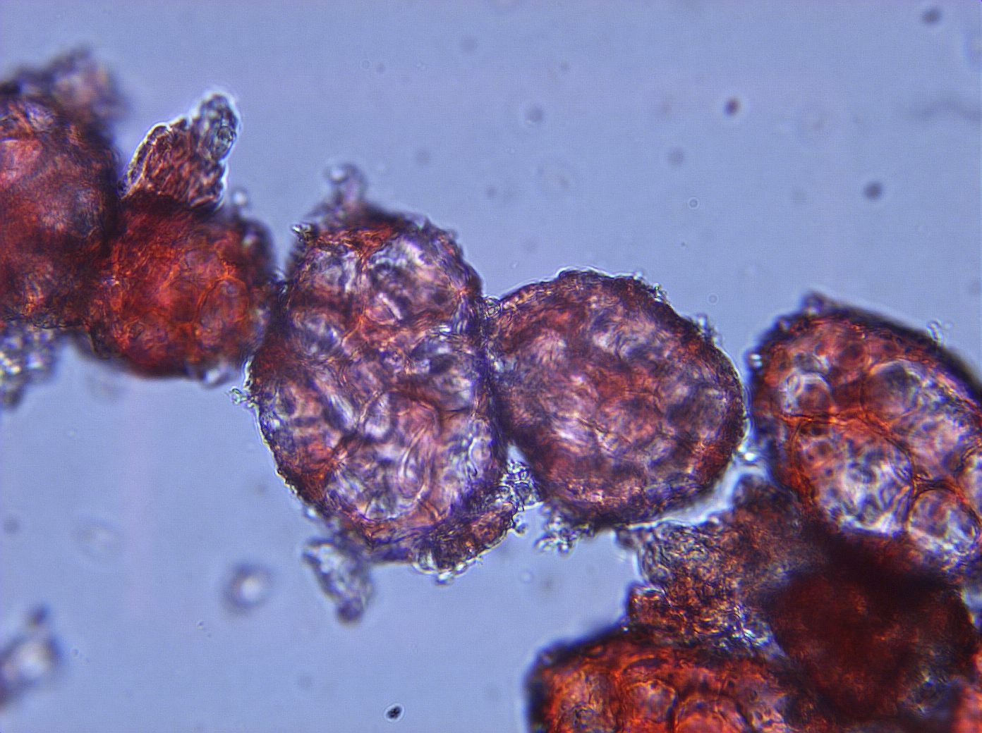
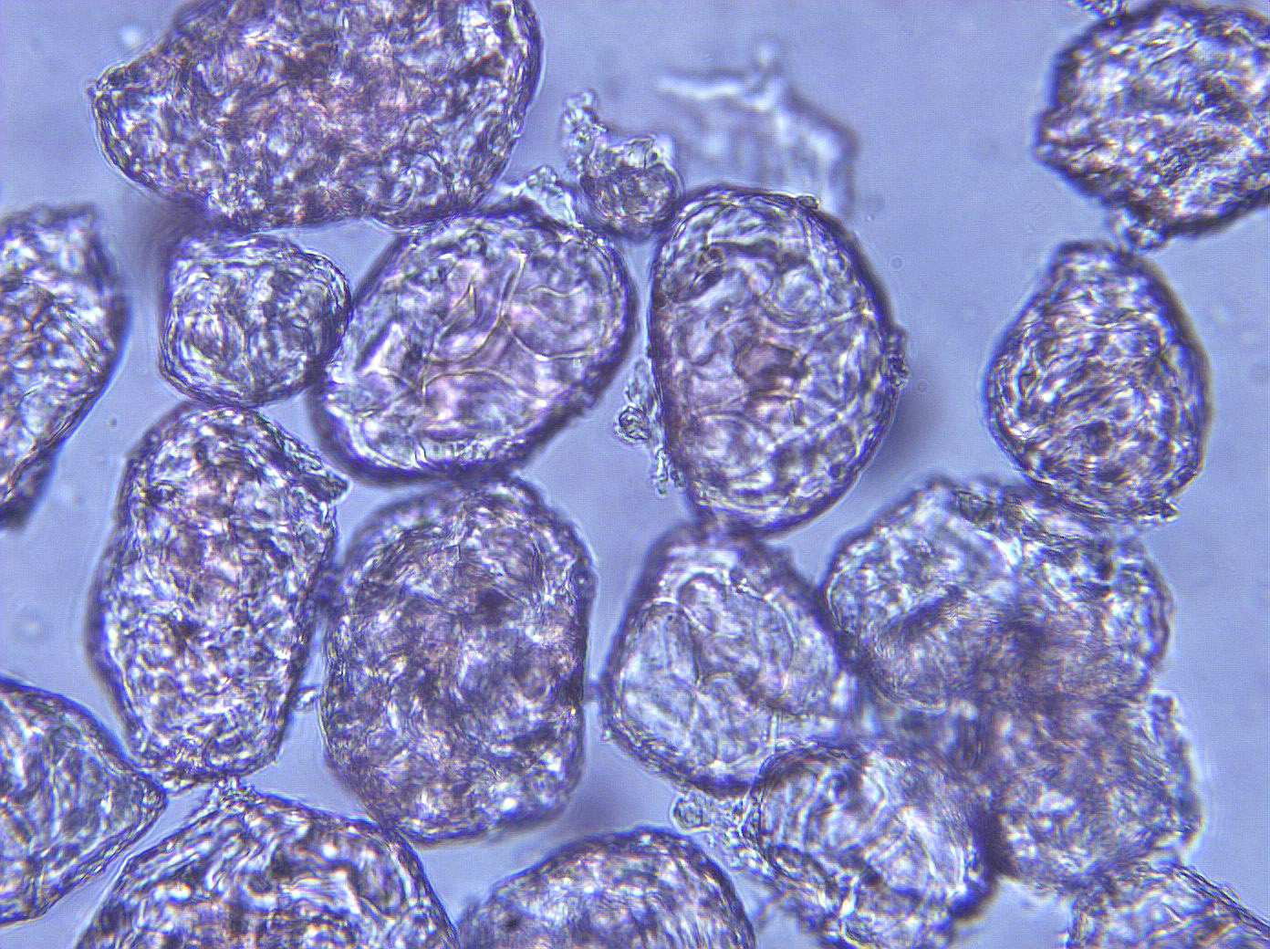
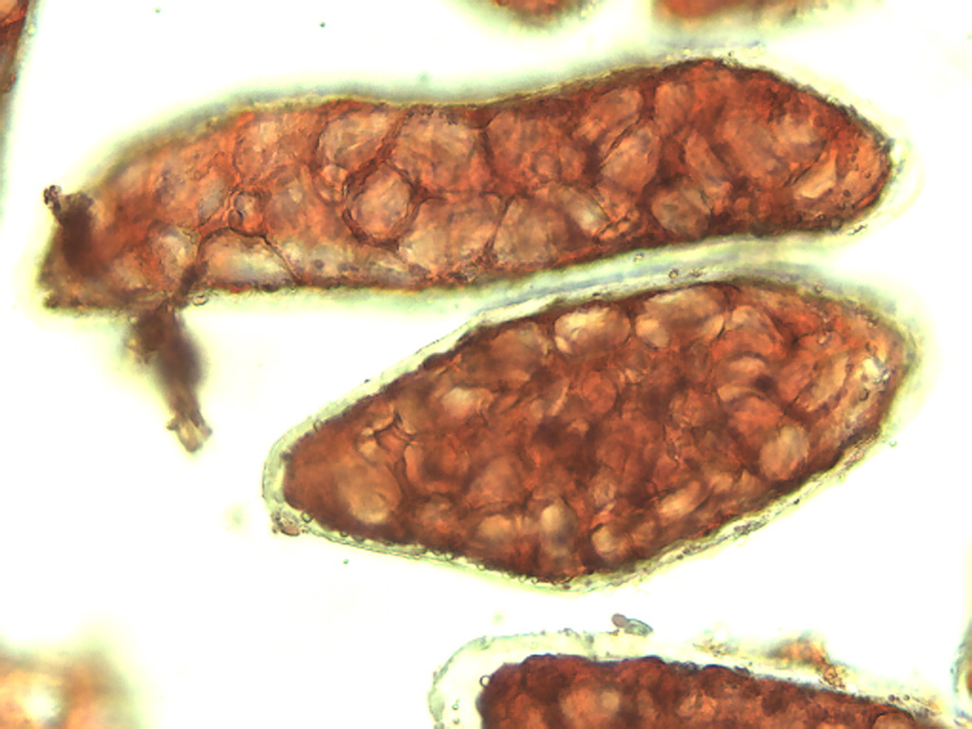
A
B
C
D
Notes:
36. Bean parenchymal cells, 25X. A. Kidney; B. Pinto, C. Lima, D. Garbanzo

